Slide 1
Slides of the figures and other useful images for
MITOCHONDRIA, THE BIG PICTURE: A PRIMER FOR STUDENTS AND RESEARCHERS

Slide 2
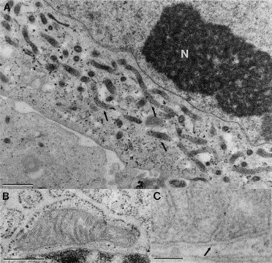
Thin section view showing evidence of the mitochondrial reticulum.

Slide 3
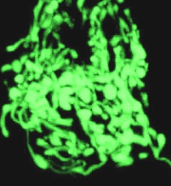
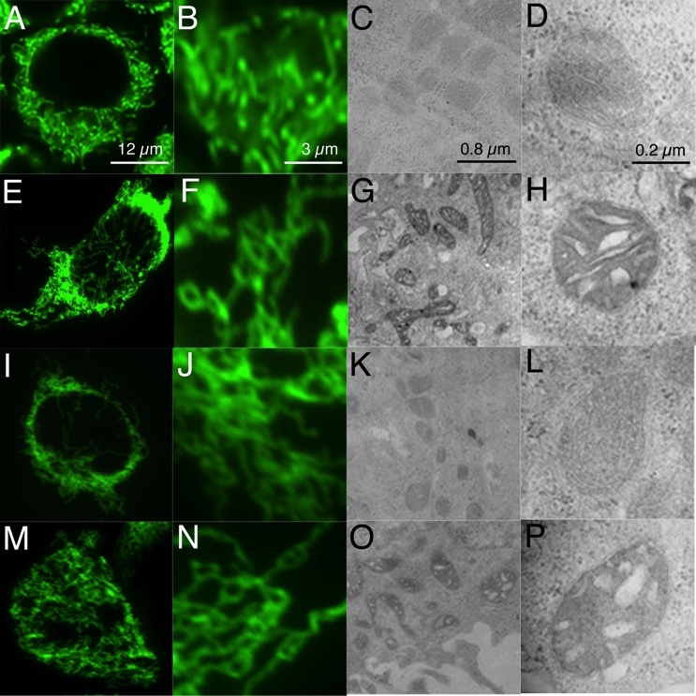
Mitochondria labelled with green fluorescent protein expressed
in the matrix space.

Slide 4
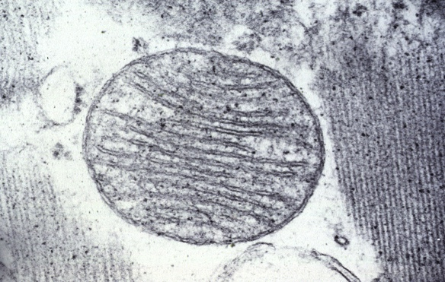
Classic picture of mitochondria from a negative stained electron micrograph

Slide 5
mamamm
Schematic showing the mitochondrial compartments.
Outer membrane
Inner boundary membrane
matrix
Intermembrane
space
Cristae membrane
Intracristal space
micos

Slide 6
GLUCOSE
Glycogen
storage
ribose
5-Pi
glycogen
G6Pi
nucleotides
Pentose Phosphate
Pathway
Glycolysis
Gluconeogenesis
lactate
Urea Cycle
PYRUVATE
amino acids
Pyruvate
Dehydrogenase
Complex
B Oxidation
fatty acids
hormones
sterols
ACETYL CoA
Fatty Acid Synthesis
Oxidative
Phosphorylation
Citric Acid
Cycle
ketone bodies
Boxed in yellow are mitochondrial pathways
CO₂ ATP
triacylglyercol
METABOLIC PATHWAYS INVOLVED IN GLUCOSE UTILIZATION.
Notes:
6

Slide 7
Short term Cellular Control of Energy Metabolism
AMP-activated Kinase
Pi
Pi
Glycogen
Synthesis
glycogen
synthase
G6Pi
creatine
kinase
Creatine Pi
Pi
HMG-coA
reductase
pyruvate
Sterol Synthesis
Pi
acetyl CoA
Acetyl-coA
carboxylase
Fatty Acid
Synthesis
Pi
GPAT
Triacylglyerol Synthesis
ATP
Fatty Acid
Oxidation
Notes:
7

Slide 8
mTORC2
mTOR: the master switch.
mTORC1
Lipid
synthesis
lipin
ATG13
AKT
SREBP
ULK1
GSK3
SIRT4
4E-BP
SK6
Glycolysis
Glutaminolysis
eiF-4E
autophagy
Mito biogenesis/OXPHOS/Krebs cycle
PGC1alpha
Mito/ER contact
YY1
mRNA translation
TFPAM
PRPS2
CAD
Complex I/IV
Nucleotide biosynthesis

Slide 9
STRESS SIGNALING AS EXEMPLIFIED BY OXIDATIVE STRESS.
Ox Stress
TRAFs
RAS
PI3K
TRX
RAF
P
U
P
AKT
active
JNK
ASK1
inactive
P
ERK1/ERK2
(P42/44MAPK)
active
P
P
C-Jun
active
mTOR
P38MAPK
active
p53
ATF2
CHOP
autophagy
CHOP
apoptosis

Slide 10
PATHWAY OF FATTY ACID SYNTHESIS
Pi
Mitochondrial
Acetyl CoA
CCytosolic Acetyl CoA
citrate
ATP citrate lyase
ACC2
ACC1
Pi
pi
ACP
(complex I
malonyl CoA
Fatty acid synthase
malonyl trnasferase
palmitate
Cytochrome b5
NNADH cytochrome b reductase
lipoate
elongated saturated
fatty acids
unsaturated
fatty acids

Slide 11
PATHWAY OF MITOCHONDRIAL FATTY ACID OXIDATION
DECR
CPT1
CPT2
ETF
unsaturated
F.A.
saturated F.A.
LCAD
VLCAD
MCAD
SCAD
acyl CoA DH’s
HADHB
short chain
enoyl-CoA
hydrolase
ETF.Q
SCHAD
ACAA2
acetyl CoA

Slide 12
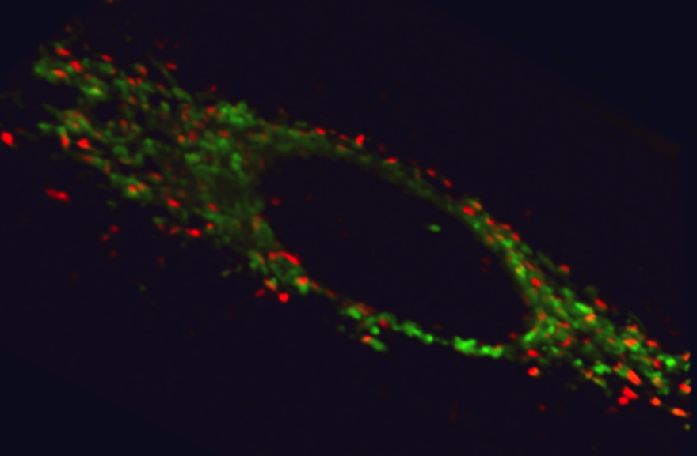
Ectopic ATP synthase, shown for HepG2 cells.
Green fluorescence shows labeled mitochondria, red fluorescence is surface F1F0 reacted with an labeled antibody to the enzymes beta subunit.

Slide 13
Mitochondrial involvement in apoptosis.
Proteins in yellow are mitochondrial.

Slide 14
Apoptosis: regulation of the levels of the anti-apoptotic protein Mcl-1.
Ubiquitin ligase
Transcriptional regul.
FBW7
PUMA
c-Myc
Ubiq
Displaces NOXA
Mcl-1
MCl1
NOXA
De-ubiquitinases
Promotes de-ubiq.
USP9X
BIM
Release from MOM
Mule
p53
Upregulates NOXA

Slide 15
Control of biogenesis by signaling through PGC1alpha.
AMPK
SIRTs
mTOR
p38MAP K
PGC-1alpha
PPARs
ERRs
CREB
NRFs
CYY1
TCA enzymes
Fatty acid oxidation
Mitochondrial biogenesis
ERRs = estrogen receptor related proteins

Slide 16
REGULATION OF METABOLISM BY PGC-1ALPHA
SIRTs
mTOR
AMPK
p38MAPK
PGC-1alpha
PPARs
ERRs
GLUT4
NRFs
Fatty acid oxidation
Glucose metabolism
Mitochondrial biogenesis
ERRs = estrogen receptor related proteins

Slide 17
Mitochondrial retrograde response
ATP/ADP/AMP.
mtUPR.
Where ATP is required for transport.
NADH/NAD+
NADPH/NADP+.
METABOLITE
SHUTTLES
Citrate
Malate
Aspartate
Glutamate
Pyruvate
Acetyl CoA
ROS/RNS.
Calcium
Where membrane potential/proton gradient drives transport
PROTEIN IMPORT/ADHERENCE etc AND RELEASE. Nfkappa B, BCl1, PINK1,MCl1
AIF,Cytochrome c etc.
Membrane potential.

Slide 18
UPR proteins in mitochondria and endoplasmic reticulum.
JNK PATHWAY
C-JUN
Induces same
genes as CHOP1
HSP60
Up reg of
Heme Oxygenase
P
PKR
p38MAPK
P
eIF2alpha
INHIBITS PROTEIN TRANSLATION
HSP90
eIF2alpha
PERK
ATF4
Up reg of
CHOP1
ER UPR(blue)
P
Mitochondrial UPR (yellow)
ATG13
APOPTOSIS

Slide 19
Inborn Errors of Metabolism and Incidence
(1:5,000) Mitochondrial disorders; (e.g., mitochondrial DNA depletion syndromes)
(1:10,000) Fatty acid oxidation disorders
inc. medium-chain acyl-CoA dehydrogenase deficiency (1:20,000)
(1:15,000) Phenylketonuria
(1:15,000) Methylmalonicaciduria. Methylmalonyl- CoA mutase, cobalamin metabolism
(1:40,000) Aminoacidopathies
(1:50,000) Peroxisomal disorders; e.g., Zellweger syndrome, neonatal adrenoleukodystrophy, Refsum's disease)
(1:150,000) Maple syrup urine disease (BCOAD)

Slide 20
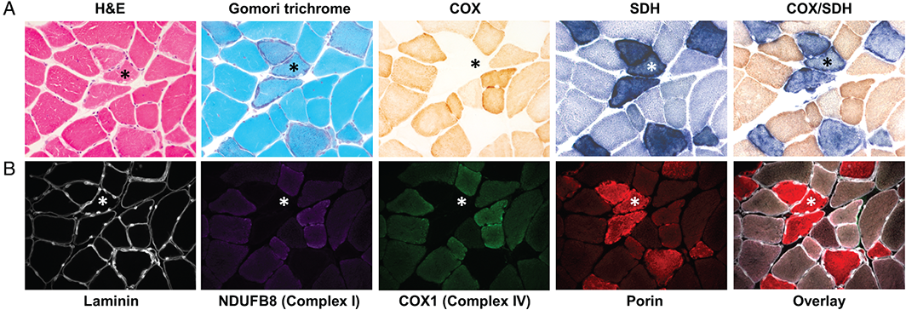
THE GENETICS AND PATHOLOGY OF MITOCHONDRIAL DISEASE
Images of skeletal muscle sections from a patient with a large scale mtDNA delection showing ragged red fibers by Gomori and altered levels of OXPHOS complexes.
The Journal of Pathology
Volume 241, Issue 2, pages 236-250, 2 NOV 2016 DOI: 10.1002/path.4809
http://onlinelibrary.wiley.com/doi/10.1002/path.4809/full#path4809-fig-0003
Notes:
Histological, histochemical and immunohistochemical hallmarks of mitochondrial pathology in primary mtDNA‐related disease. (A) Serial skeletal muscle (vastus lateralis) sections from a patient with a single, large‐scale mtDNA deletion were stained with H&E and modified Gomori trichrome to assess basic muscle morphology and the presence of RRFs, respectively. The individual COX, SDH and sequential COX/SDH histochemical reactions show fibres manifesting mitochondrial accumulation and focal COX deficiency. (B) The lack of histochemical assays to assess other OXPHOS complex activities prompted the development of a quadruple immunofluorescence assay that can quantify the levels of complex I (NDUFB8 subunit), complex IV (COX1 subunit), laminin, and a mitochondrial mass marker (porin), all within a single 10‐µm section. A highlighted COX‐deficient fibre (*) shows focal accumulation of sarcolemmal mitochondria around the periphery of the fibre, and downregulated expression of both complex I and IV proteins. (All images taken at ×20 objective magnification.)
IF THIS IMAGE HAS BEEN PROVIDED BY OR IS OWNED BY A THIRD PARTY, AS INDICATED IN THE CAPTION LINE, THEN FURTHER PERMISSION MAY BE NEEDED BEFORE ANY FURTHER USE. PLEASE CONTACT WILEY'S PERMISSIONS DEPARTMENT ON PERMISSIONS@WILEY.COM OR USE THE RIGHTSLINK SERVICE BY CLICKING ON THE 'REQUEST PERMISSIONS' LINK ACCOMPANYING THIS ARTICLE. WILEY OR AUTHOR OWNED IMAGES MAY BE USED FOR NON-COMMERCIAL PURPOSES, SUBJECT TO PROPER CITATION OF THE ARTICLE, AUTHOR, AND PUBLISHER.

