Slide 1
Welcome to Alexandria!
2019 LHON Conference
Notes:
My name is Lissa Poincenot. I’d like to welcome all of you to our 7th annual LHON Conference!

Slide 2
LHON Conference Steering Committee
Lissa Poincenot
Molly Knox
Maria Johnson
Lisa Thompson
Jennifer Malecha
Susie Janov
Wayne Daniels
Cindy Scott-Huisman
Hope Gelbach
Notes:
Right after last year’s Conference ended, several of us began discussing how to make this year’s conference even better than ever. And we’ve continued the discussions throughout the past year, working to ensure each of you has a rewarding LHON Conference experience this year. I’d like each person on the Conference Steering Committee to just say their name, where they live, and their connection to LHON. I’m Lissa Poincenot…I live in San Diego, and my oldest son became affected by the LHON 11778 mutation about 10 years ago. [Others]
Now that you’ve heard their voices, you know who to turn to when you have any questions about the Conference.
Personally, I’ve had more fun working on the Conference planning this year than ever before. It’s been great to work with this creative, hard-working team of people who are dedicated to ensuring that each of you has a great experience before, during and after your time here in Alexandria. It’s all about developing the LHON community, and having you here makes it all so much better!

Slide 3
Notes:
Over the past 10 years, I’ve had lots of fun doing a wide range of activities to develop the LHON community, and various folks have volunteered to help in a wide variety of ways.
Over the next few years, I plan to focus on developing a more structured approach to defining the ways people can volunteer, and to developing a strong volunteer organization.
Molly and I created this Organization Chart, and we’re passing out copies for those who’d like one. Please give some thought as to whether any of these areas might be of interest to you. Just as we had the Conference Steering Committee, so half the fun was collaborating on the project, I envision each of these topics being handled by a team of volunteers, never just one person.
[Walk Through the Org Chart]
So just know that this is the beginning of a Work-in-Progress, and there’s a place for everyone in the LHON community who wants to help make the community as strong as it can be. We don’t have a lot of funds, and everything we do is on a volunteer basis. So the more people willing to be a part of it, the more we’ll be able to do.

Slide 4
Notes:
I’ve been trying to get a lot done for the benefit of the LHON Community over the past 10 years, and I’ve felt the need to go fast.
And while I’ve had some great support and collaboration from several folks, now it’s time to transition and to go much farther, together.
Usually I talk about the Global LHON Community at the end of each Conference, and I’ll do that tomorrow as usual. But I wanted to plant this thought in your minds as you meet people and think about LHON during our time together, so you can think about where you might most enjoy contributing your time and talent to the LHON community.

Slide 5
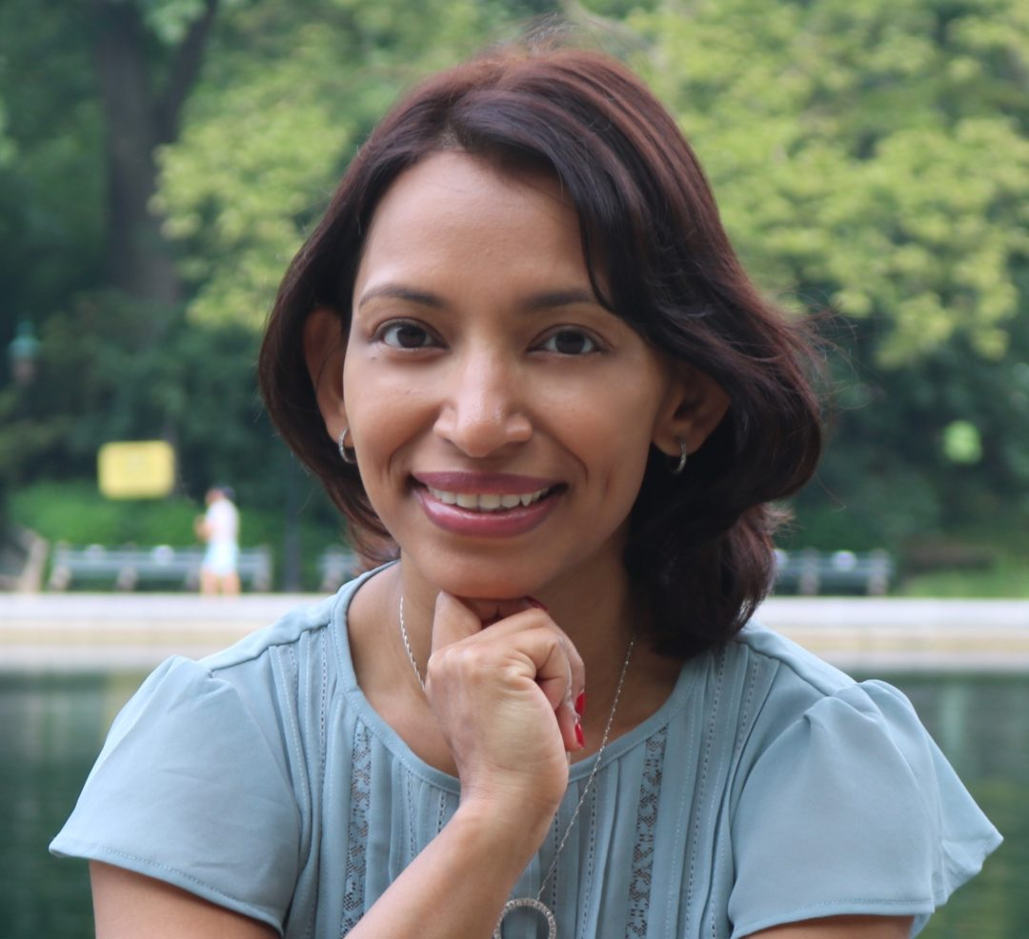
Rudrani Banik, MD
Notes:
Once again, welcome, and we’re all glad you’re here! I’d like to introduce our first speaker. Dr. Rudrani Banik is an Ophthalmologist in New York City, fellowship trained in Neuro-Ophthalmology, and a Functional Medicine expert. She has a special interest in treating Headache and Migraine. She applies principles of complementary and alternative medicine in conjunction with traditional medical approaches to treat chronic diseases affecting the visual system.
Dr. Banik has treated LHON patients in the GenSight gene therapy trial, and the Santhera LEROS trial.
Dr. Banik offered to come here today and give a talk on an Integrative Approach to LHON. I look forward to hearing her talk; please welcome Dr. Banik!

