Slide 1

LHON/LHON plus
Andrea Gropman, M.D., FAAP, FACMG, FANA
Children’s National Health System
George Washington University Medical Center

Slide 2
LHON
Leber's hereditary optic neuropathy or Leber hereditary optic atrophy
  Mitochondrially inherited degeneration of retinal ganglion cells and their axons
  Leads to an acute or subacute loss of central vision

Slide 3
LHON
Affects predominantly young adult males but is not X-linked
LHON is only transmitted through the mother
  Due to mutations in the mitochondrial genome, and only the egg contributes mitochondria to the embryo

Slide 4
LHON
Usually begins between ages 15-35 but can occur at any age
  Leads to legal blindness
59% prevalence rate of neurological abnormalities associated with LHON

Slide 5
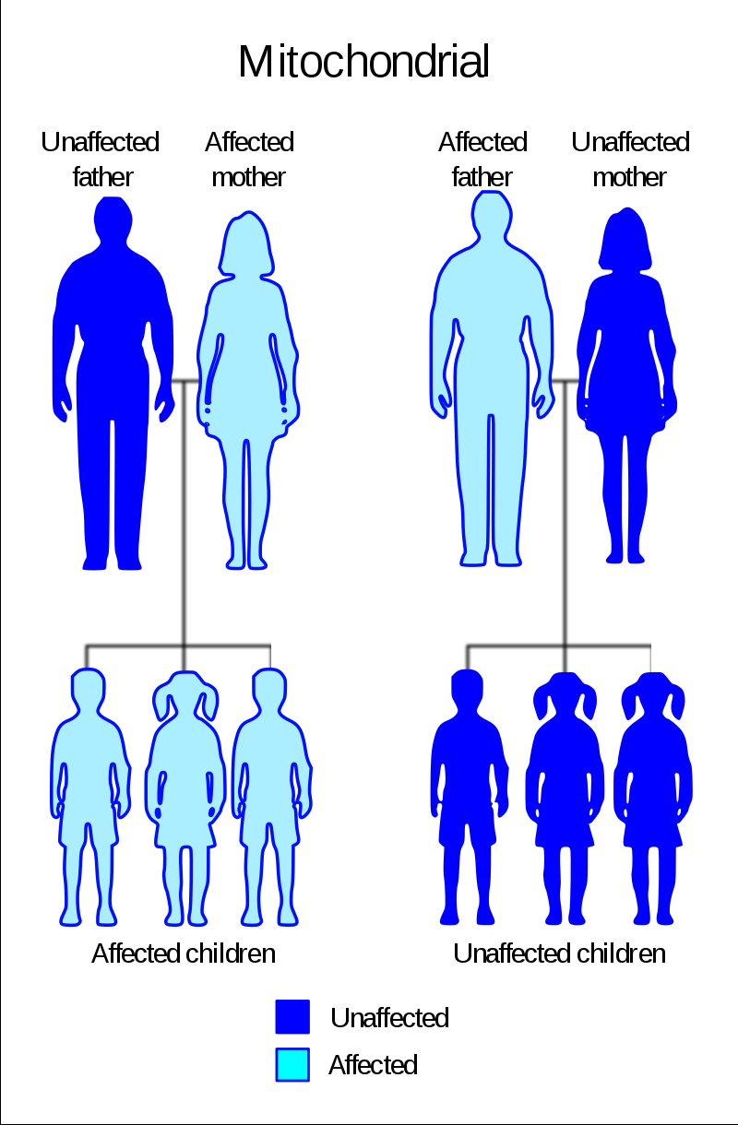
Maternal inheritance

Slide 6
LHON
  LHON: one of three pathogenic mutations
    11778 G to A
    3460 G to A
    14484 T to C
    ND4, ND1 and ND6 subunit genes of complex I of the oxidative phosphorylation chain in mitochondria

Slide 7
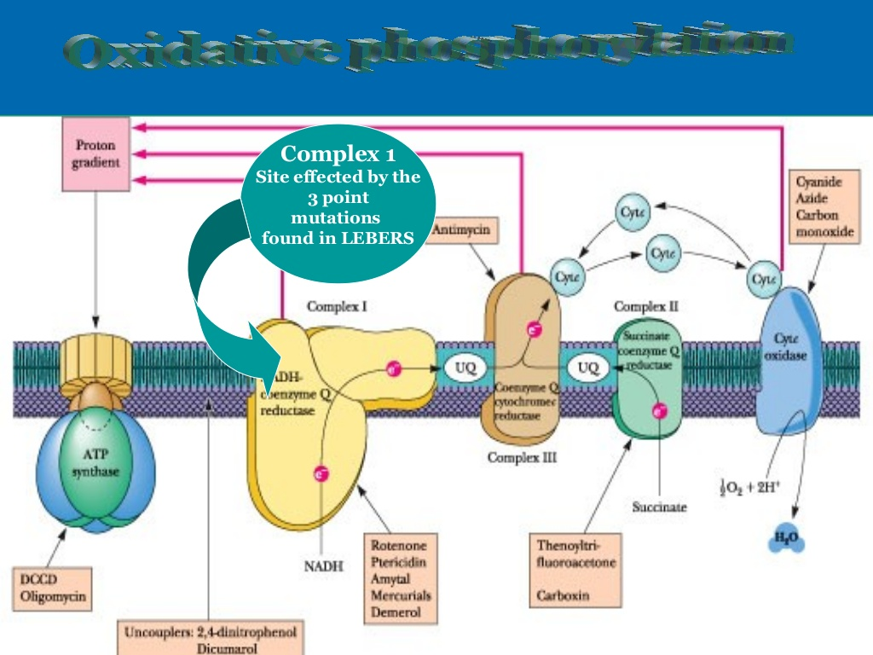

Slide 8
LHON plus
(other symptoms)
Multiple sclerosis like symptoms
Eye
  Double vision
  Optic disc swelling
  Vision loss

Slide 9
LHON plus symptoms: other neurological
Motor problems
  Stiff walking
  Spasticity
Bowel and bladder problems

Slide 10
Neurological issues
Migraine headaches
Cognitive issues
Neuropathy
  i.e. Loss of vibration sensation (usually starts in the feet)
Seizures
Tremor

Slide 11
Neurological issues
Movement disorders
    Tremors
    Dystonia (fixed postures)
    Parkinsonism
  Speech issues

Slide 12
MRI findings
Small lesions, periventricular
Same location of lesions as seen in Multiple sclerosis, MS

Slide 13
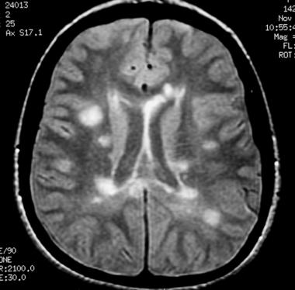

Slide 14
LHON Plus
MRI: deep gray matter lesions
The basal ganglia are believed to be especially vulnerable to injury in mitochondrial disease due to high energy requirements and increased free radical formation

Slide 16
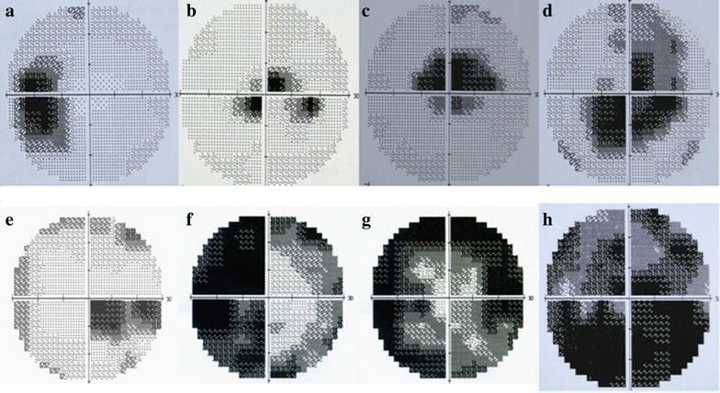

Slide 17
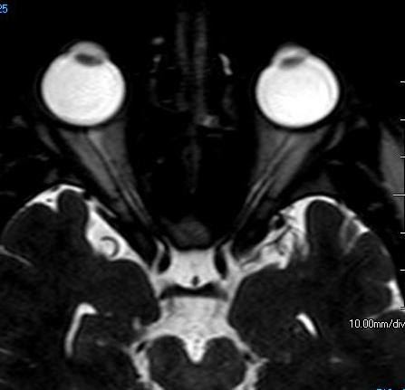
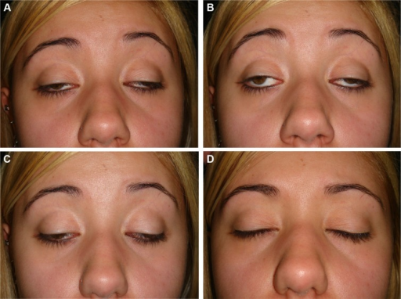

Slide 18
LHON plus: etiology
Progressive microangiopathy
A disease of the capillaries (very small blood vessels), in which the capillary walls become so thick and weak that they bleed, leak protein, and slow the flow of blood

Slide 19
LHON plus: etiology
Optic nerve degeneration in LHON is due to disturbed mitochondrial function and a predominantly complex I respiratory chain defect has been identified
However, the trigger for RGC loss is much more complex than a simple bioenergetic crisis

Slide 20
LHON plus: etiology
Other important disease mechanisms have emerged
The downstream consequences of these mitochondrial disturbances are likely to be influenced by the local cellular milieu

Slide 21
LHON plus: etiology
The vulnerability of RGCs in LHON
  derive not only from tissue-specific, genetically-determined factors
  increased susceptibility to exogenous influences such as light exposure, smoking, and pharmacological agents with putative mitochondrial toxic effects

Slide 22
LHON Plus
Most cases with optic atrophy and dystonia have 11696G>A,14459G>A, or 14596T>A

Slide 23
LHON Plus
LHON “plus” disease with childhood onset has been described infrequently
To the best of our knowledge, few pediatric patients with the 11778G
A LHON mutation have been reported with atypical Leigh-like

Slide 24
LHON plus
LHON plus is the name given to a rare variant of the syndrome with eye disease and other symptoms

Slide 25
LHON and LHON plus treatment
Management of affected individuals is largely supportive, with the provision of visual aids, help with occupational rehabilitation, and registration with the relevant social services

Slide 26
LHON and LHON plus treatment
ECG may reveal a pre-excitation syndrome in individuals harboring a mtDNA LHON-causing pathogenic variant; referral to cardiology can be considered and treatment for symptomatic individuals is the same as that in the general population

Slide 27
LHON and LHON plus treatment
Treatment for raised intraocular pressure in individuals who have a LHON-causing pathogenic variant
Agents/circumstances to avoid: Individuals harboring a mtDNA LHON-causing pathogenic variant should be strongly advised to moderate their alcohol intake and not to smoke

Slide 28
LHON and LHON plus treatment
Avoid exposure to other putative environmental triggers for visual loss, in particular industrial toxins and drugs with mitochondrial-toxic effects

