Slide 1

Living with LHON: Education
Jennifer Malecha
June 29, 2019

Slide 2
Disclaimer
This information was collected from affected individuals and families of affected individuals. Every situation is different, the degree of vision loss is not the same. This is to be used as a tool for ideas and not intended for total educational care of an individual affected by LHON.

Slide 3
Concepts
Protecting Students With Disabilities
  What are your rights?
  How can this be done at various ages?
504 & IEP Plans
Accommodations/Assistive Technology
Teacher of the Visually Impaired (TVI)
Education options for adults

Slide 4
Issues
Wide range of vision (dis)ability with LHON
Obtaining Resources and Equipment
Obtaining Accessible Materials
Informing Teachers/School/Administration
Informing Other Students
Time Management

Slide 5
Rehabilitation Act of 1973
The Rehabilitation Act prohibits discrimination on the basis of disability in programs conducted by Federal agencies, in programs receiving Federal financial assistance, in Federal employment, and in the employment practices of Federal contractors. The standards for determining employment discrimination under the Rehabilitation Act are the same as those used in Title I of the Americans with Disabilities Act.

Slide 6
IDEA 2004
Individuals with Disabilities Education Act (IDEA). This is the law that makes available a free appropriate public education to eligible children with disabilities throughout the nation and insures special education and related services to children with disabilities.

Slide 7
What is a 504 Plan
The 504 Plan is a plan developed to ensure that a child who has a disability identified under the law and is attending an elementary or secondary educational institution receives accommodations that will ensure their academic success and access to the learning environment.

Slide 8
What is an IEP
The Individualized Educational Plan (IEP) is a plan or program developed to ensure that a child who has a disability identified under the law and is attending an elementary or secondary educational institution receives specialized instruction and related services.

Slide 9
Assistive Technology
Under IDEA 2004 the law requires schools to use assistive technology devices and services to maximize accessibility for children with disabilities.
If your IEP team determines that your child needs assistive technology devices and services, the school district is responsible for providing these and cannot use lack of availability or cost as an excuse.
The law also requires schools to provide assistive technology training for teachers, child and family

Slide 10
Elementary/High School
Accommodations that may need to be addressed but not limited to in a 504 and can be added to an IEP
Extra time for homework
Larger font size (if it helps)
Frequent breaks – neck fatigue, eye strain, headache
Extra time for test
Test being read
Enlarged print/emailed form format homework/worksheets
Seat placement/extra desk space near an outlet
Audio Books/Assistive technology
EA (Education Assistant) helping
Early Hall passing if necessary

Slide 11
Possible Goals for an IEP
An IEP is a personalized education plan, do not use this just to accommodate, but to help your child excel.
Self-Advocacy
Orientation and Mobility
White Cane Proficiency
Braille
Technology Training
Transition Services
These goals have smaller benchmarks/or short term goals so your goal is more attainable.

Slide 12
Teacher of the Visually Impaired (TVI)
Assess and help with accommodations
May be trained in orientation and mobility to train your student
May be able to teach Braille to your student
Part of the IEP team
Knows what kind of technology will be suitable
Helps advocate for the accommodations and technology needs

Slide 13
Accessing Information
Support
  Readers, scribes
  Parents, other students
Magnification
  Ruby
  Portable CCTV's (VisioBook, Connect 12 Electronic Magnifier, etc.)
  Talking rulers/Talking calculators
VoiceOver
JAWS
Braille
Bookshare
iPad/iPhone with assistive Apps

Slide 14
Standardized Testing
Accommodations needed for VI test-takers
ACT/SAT Test accommodations must be requested in writing and approved.
State Testing accommodations can be made and requested.

Slide 15
Schools for the Blind
Do your research
Check out Blind Schools
How far away
Live in/commute to
Up to date technology
Braille
Learn classes with others that are visually impaired
IEP are set up to the individuals needs as in regular schools
Learn basic living skills
Forms bonds with others with a visual impairment

Slide 16
College & Grad School
College Disability Office
College Counselors are available and helpful
Financial Aid (FAFSA)
Scholarship
Orientation and Mobility Training at school
Learning Platform/technology for
online learning and class learning
Technology is it compatible with the college?
Learningally.org

Slide 17
Practical Tips
Encourage teachers to be vocal about what they write on the board
Encourage everyone to move quickly, as LHON vision loss occurs so much faster than anything they’re accustomed to dealing with
Remind the IEP/504 team that your child is different than others on these plans. Most children with LHON do not have a learning disorder. Help push for your student to excel.
SELF ADVOCACY!!
Helping teachers understand LHON
prior to class (possible power point)

Slide 18
Philosophical Tips
Self-advocacy’s important
  Involve the student in discussions & decisions
Guide educators not just to accommodate the student, but to help them excel
Check out www.parentcenterhub.org for parent resource centers in your state and webinars.
Michael Malecha's PowerPoint
https://lookaside.fbsbx.com/file/My%20disability.pptx?token=AWzDvtu0exy0ZHZkOCVWTJqkziZfMhpftQW8zvpwCSuLEvthoHnAHN-9Y2OrqRVS8O_bIQ_DJovfEJaEndGRW6ne8JGe9xwjrJUxVSAfnAB2aNlkPjnAGJYXr9_QdpdI-5Pr3wXRy1WUupq37Ft68s3ghOZcgsxZKllH9akjvyxK2XHqBG3RKyZS5PzZJO6rVROzORQFhXnwfdg0RUb9FlqN

Slide 19
Scholarships
NFB Scholarship Program
College Scholarships
ABC Scholarships
Lighthouse Guild Scholarships
Christian Record Services Scholarship
AFB Scholarship
Learning Ally's National Achievement Awards
Own school, organizations like the Lions Clubs

Slide 20
Blindness Training
What type of rehab program
Basic Living Skills
Orientation and Mobility training
Find what you need to make the most of your life
Check with your State. Many states have services available.

Slide 21
Hadley.edu

Slide 22
Being a Teacher
Prove yourself – any job​
Things take longer – any job​
Behavior- be tough and firm in beginning​
Use what works best – white board/smartboard​
Magnifier, CCTV, Laptop (JAWS)​
Seems like you do a better job, always trying to prove yourself
Classroom is verbal/no raising of hands, has person say their name before question
Does have an EA in the classroom for attendance, but not to help with teaching

Slide 23

Facebook Group
Navigating Education/School With LHON FB Group

Slide 24
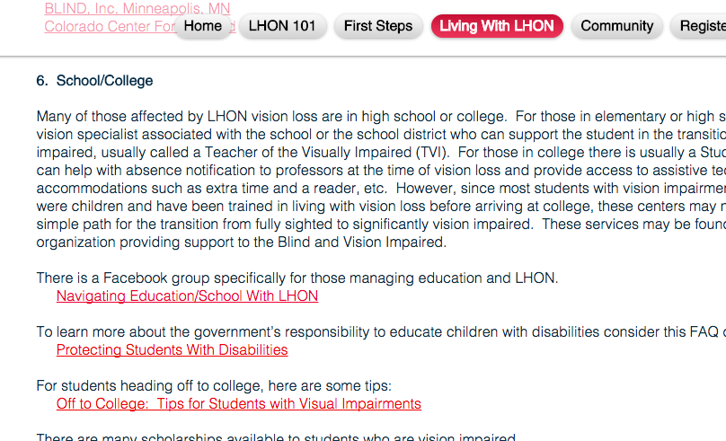
LHON.org
www.lhon.org/living-with-lhon

Slide 25
Living with LHON: Education

