Slide 1
Understanding the Basics
Contents
Disability Programs
How We Define Disability
Substantial Gainful Activity (SGA)

Slide 2
Disability Programs
Title II
SSDI
Social
Security Disability Insurance
Medicare
Title XVI
SSI
Supplemental Security
Income
Medicaid

Slide 3
Disability Defined
To meet our definition of disability, you must be unable to engage in any substantial gainful activity (SGA) because of a medically-determined physical or mental impairment(s):
that has lasted or is expected to last for a continuous period of at least 12 months, or
that is expected to result in death.
Note: There is a separate definition of disability for children (under age 18) who are applying for the Supplemental Security Income (SSI) program. A disabled child also qualifies for the SSI employment supports.

Slide 4
Substantial Gainful Activity
“Substantial gainful activity” (SGA) is a term used to describe a level of work activity and earnings. We generally use earnings guidelines to evaluate whether your work activity is SGA.
If the impairment is anything other than blindness, earnings in 2019 averaging over $1,220 a month generally demonstrate SGA.
The SGA amount in 2019 for blind individuals is $2,040.
SSI only uses SGA as a measure of work during initial claims.
SSDI uses SGA throughout the life of the claim.

Slide 5
What are Work Incentives?
Employment support provisions that assist beneficiaries in moving from benefit dependency to independence
Designed to help beneficiaries enter, re-enter, or stay in the workforce by protecting their eligibility for cash payments and/or health care

Slide 6
SSDI and/or SSI Employment Supports
Contents
Subsidies and Special Conditions
Unsuccessful Work Attempt (UWA)
Impairment-Related Work Expenses (IRWE)
Plan to Achieve Self-Support (PASS)
Ticket to Work (TTW)
Expedited Reinstatement (EXR)

Slide 7
Subsidies and Special Conditions
What is a subsidy?
A “subsidy” is support provided by your employer that may result in you receiving more pay than the actual value of the services you perform.
What are special conditions?
“Special conditions” refer to support and on-the-job assistance provided by your employer, or by someone other than your employer, for example, a vocational rehabilitation agency. Because of this support, you may receive more pay than the actual value of the services you perform.

Slide 8
Unsuccessful Work Attempt (UWA)
An Unsuccessful Work Attempt (UWA) is an effort to do work, in employment or self-employment, which you stopped or reduced to below the SGA level after a short time (within 6 months) because of:
your impairment, or
removal of special conditions related to your impairment that you needed to help you work.

Slide 9
Impairment-Related Work Expenses (IRWE)
We deduct the cost of certain impairment-related items and services that are needed to work from gross earnings when we decide if your work is SGA.
Example:
Beneficiary is earning $1200.00 per month in gross wages. His monthly co-pay for his medications is $75.00.
$1200 - $75 = $1125 - This is countable income when determining SGA.

Slide 10
Impairment-Related Work Expenses (IRWE)
Type of Expense | Example
Transportation Costs | The cost of structural or operational modifications to vehicle that is needed to travel to work. The cost of driver assistance or taxicabs if public transportation is not available or not accessible.
Attendant Care Services | Services performed in the work setting. Services performed to help prepare for work, the trip to and from work and after work.
Service Animals | Expenses paid in owning a guide dog or other service animal that enables beneficiary to overcome functional limitations in order to work.
Medical Devices | Deductible devices include wheelchairs, dialysis equipment, pacemakers, respirators, traction equipment, and braces.
Prosthesis | Artificial hip, artificial replacement of an arm, leg, or other parts of the body.
Residential Modifications | Employed outside of home - modifications to exterior to permit access to the street or transportation. Self-employed at home - modifications inside to create workspace to accommodate impairment.
Prescription Drugs | Regularly prescribed medical treatment or therapy that is necessary to control disabling condition. This includes co-payments and insurance deductibles.
Other Items and Services | Assistive technology that people with disabilities use for employment–related purposes; such as software applications, computer support services, and special tools which have been specifically designed to accommodate the person’s impairment

Slide 11
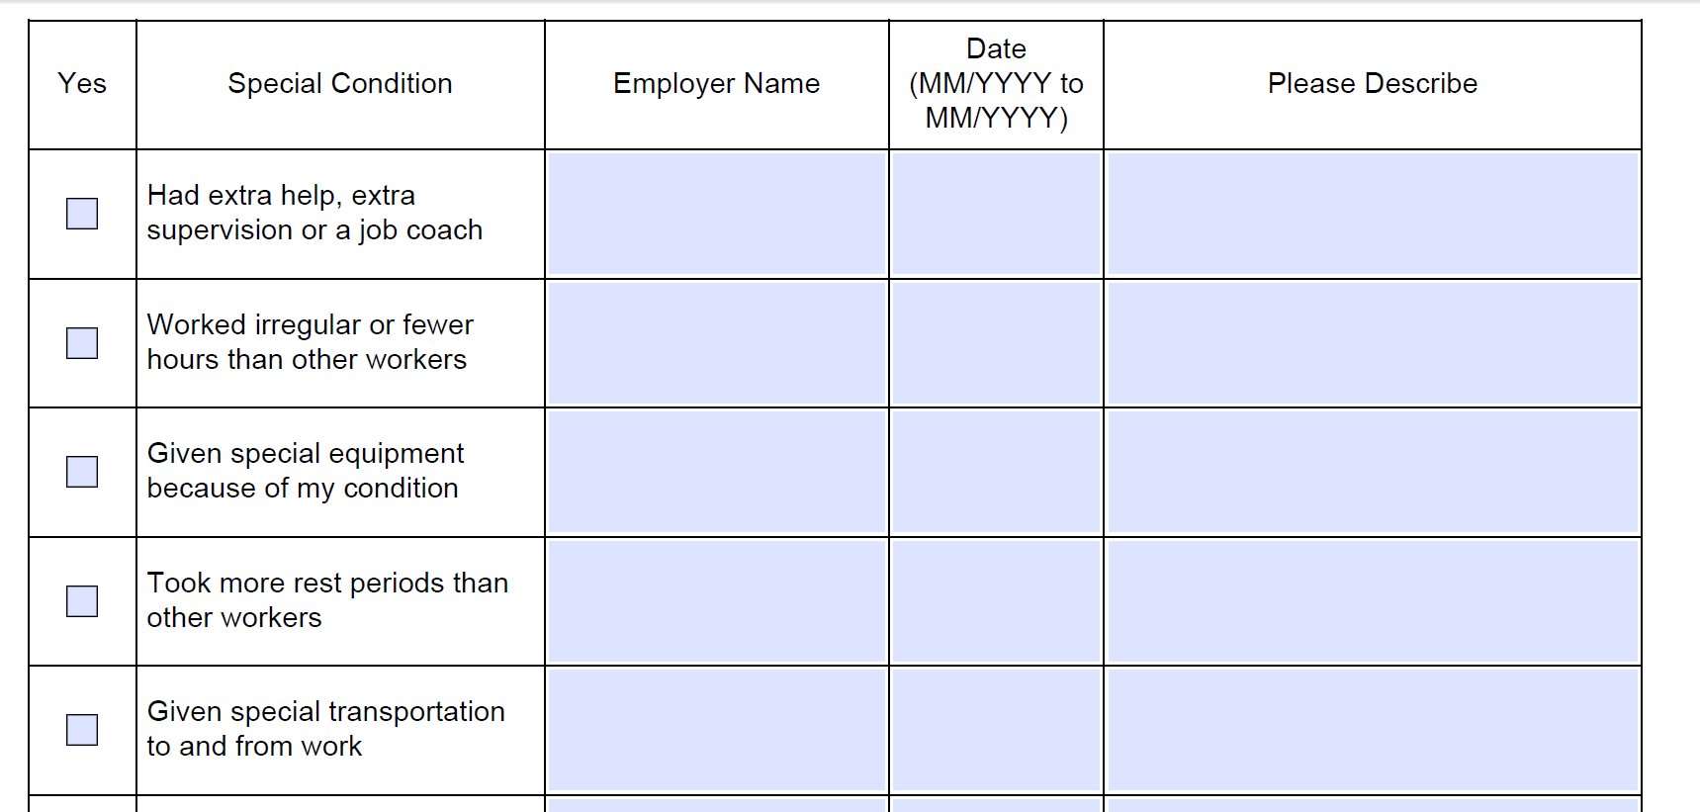
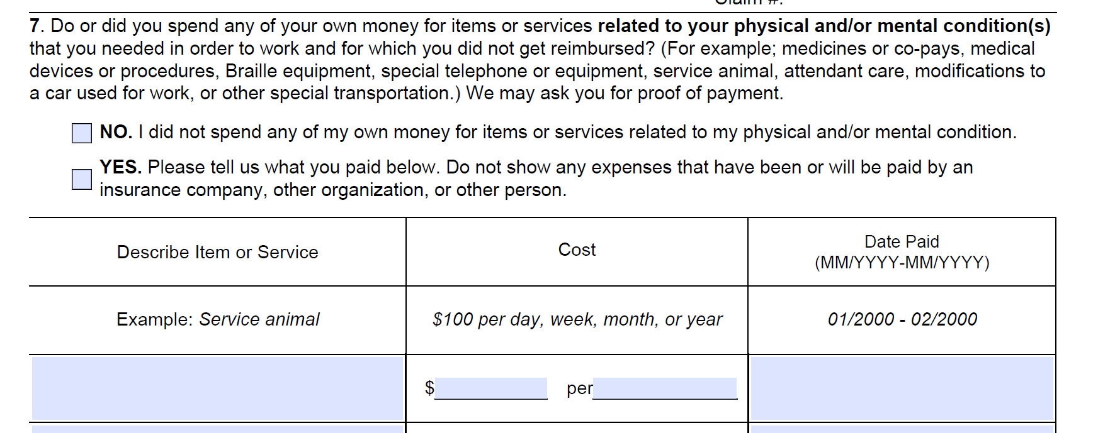
Form SSA-821 Work Activity Report
SSA-821 is used to document work activity and work incentives when SSA is making SGA decisions.

Slide 12
Plan to Achieve Self-Support (PASS)
What is a PASS?
A PASS is an SSI provision to help individuals with disabilities return to work.
If you receive SSI or could qualify for SSI after setting aside income or resources so that you may pursue a work goal, you could benefit from a PASS.
How does a PASS help someone return to work?
We base SSI eligibility and payment amounts on income and resources.
A PASS lets a disabled individual set aside money and things he/she owns to pay for items or services needed to achieve a specific work goal.
The objective of a PASS is to help disabled individuals find employment that reduces or eliminates SSI or SSDI benefits.

Slide 13
Plan to Achieve Self-Support (PASS)
What kinds of expenses can a PASS help pay for?
School or training expenses - tuition, fees, books, and supplies
Uniforms, special clothing, safety equipment, tools
Attendant care of child care expenses
Transportation for work
Employment services such as a job coach
Supplies to start a business

Slide 14
Plan to Achieve Self-Support (PASS)
A Sample PASS Example (SSI ONLY)
Wages being excluded under an approved PASS
Billy wants to go to school to become a social worker.
Billy works part time and earns $665 per month.
We figure Billy’s countable income using the earned income formula. $665 - $20 = $645 - $65 = $580. $580 / 2= $290 in countable income.
Billy’s earned income reduces his SSI benefit of $735 by $290 per month to $445.
He agrees to spend the $290 in countable income on his education and we approve a PASS.
We set aside this income and his SSI increases by $290/month for the PASS timeframe. Billy receives $735 in SSI benefits, and has $290 to use for approved PASS expenses.

Slide 15
Plan to Achieve Self-Support (PASS)
A Sample PASS Example (SSDI Only)
SSDI being excluded under an approved PASS
Maria wants to go to school and become a paralegal.
She receives $800 in SSDI benefits.
Maria’s employment goal needs to be expected to generate enough income to eliminate SSDI - (have expected earnings over $1,220 per month SGA for 2019).
Maria determines she needs $780 per month for tuition, books, and school supplies. We can deduct the $780 in school expenses from her SSDI benefit and deduct the remaining $20 (general SSI exclusion) so that her SSDI benefit is not countable income and she is eligible for the full SSI payment of $771 (for 2019).
Maria must use the SSI payment of $771 for living expenses and use the PASS funds of $780 for approved plan expenses.

Slide 16
Ticket to Work (TTW)
TTW is an innovative program for persons with disabilities who want to work and participate in planning their employment.
It increases your available choices when obtaining employment services, vocational rehabilitation (VR) services, and other support services you may need to get or keep a job.
It is a free and voluntary service.
You can use the Ticket if you choose, but there is no penalty for not using it.

Slide 17
Ticket to Work (TTW)
For more information on the TTW Program, including a list of approved Employment Networks (ENs), call:
1-866-YOURTICKET (1-866-968-7842)
OR
TTY 1-866-833-2967
between 8 a.m. to 8 p.m. Eastern time Monday through Friday.
socialsecurity.gov/work

Slide 18
Expedited Reinstatement (EXR)
What is EXR?
EXR is your safety net if your cash benefits end because of your work. If you make less money or you have to stop working because of your disability, we may be able to restart your benefits right away if:
you stop working above the SGA level, and
your disability is the same as or related to your current disability, and
you make your request within 5 years of when your benefits end.
How does EXR help you?
The EXR provision allows you to receive up to 6 months of temporary cash benefits while we conduct a medical review to decide if we can reinstate your benefits. You may also be eligible for Medicare and/or Medicaid during this provisional benefit period.

Slide 19
Trial Work Period (TWP)
Allows SSDI beneficiaries time to test their ability to work
9 Months, not necessarily consecutive
“Rolling” 60 month period
Full SSDI benefit continues regardless of earnings
Months with $880 in gross earnings (2019) or more than 80 hours of self employment are considered TWP months.
Cannot begin before the month of entitlement or the month of filing, whichever is later

Slide 20
Trial Work Period (TWP)
You are not eligible for disability benefits or a TWP if you work at the SGA level within 12 months of the start of your impairment(s) and before we approve your claim for disability benefits.
It is possible for your benefits to stop due to your medical recovery before the end of your TWP.
We do not apply work incentive rules when determining the service months in your TWP.

Slide 21
Extended Period of Eligibility (EPE)
The EPE begins the month after the Trial Work Period (TWP) ends, even if you are not working that month.
The first 36 months of the EPE is the re-entitlement period.
During the re-entitlement period:
-if work or monthly earnings are below SGA, benefits are payable;
-if work or monthly earnings are above SGA, benefits are suspended.
EPE ends with the later of:
-the month before the first month of SGA earnings after the re- entitlement period, or
-the second month after the month of disability cessation due to SGA.

Slide 22
Extended Period of Eligibility (EPE)
Cessation Month and Grace Period:
Cessation Month - the first month work or monthly earnings exceed SGA after the end of the TWP
Grace Period - the two months immediately following the cessation month
> NOTE: Benefits are paid for the cessation month and the grace period, whether or not the beneficiary is earning over SGA.

Slide 23
Extended Period of Eligibility (EPE)
Benefit Termination Month (BTM):
When an SGA cessation occurs within the first 36 months of the EPE, the BTM is the first month of SGA after re-entitlement period.
Example: SGA performed in the 16th, 17th, and 42nd month of the EPE. Month 16 = Cessation, Months 17 and 18 = grace months, Month 42 = BTM
When an SGA cessation occurs in or after the 36th month of the EPE, the BTM is the third month after the cessation month.
Example: SGA performed in month 36th of the EPE. Month 36 = Cessation, Month 37 and 38= grace months, Month 39 = BTM

Slide 24
Continuation of Medicare Coverage
Although cash benefits may cease due to work, continued health insurance is possible.
Most beneficiaries who work will continue to receive at least 93 consecutive months of Part A; Part B (if enrolled); and Part D (if enrolled). There is no premium for Part A.
The 93 months start the month after the last month of the TWP.
To qualify, beneficiary must already have Medicare and be working at SGA level but not medically improved.

Slide 25
Medicare for Persons with Disabilities Who Work
After premium-free Medicare coverage ends due to work, a disabled individual may buy continued Medicare coverage as long as he/she remains medically disabled.
To qualify, the individual:
must be under age 65, and
continue to have a disabling impairment, and
Medicare must have stopped due to work.
Hospital Insurance (Part A) is available for $437.00 per month in 2019. Supplemental Medical Insurance (Part B) is available for $135.50 per month in 2019.

Slide 26
Responsibilities When Beneficiary Returns to Work
Notify Social Security of any changes in work activity:
Start or stop work;
Work has been reported but duties, hours, or pay have changed;
Start paying for expenses that are needed to work due to the disability.
Report changes in work activity by phone, fax, mail or in person.
Call 1-800-772-1213 between 7 a.m. and 7 p.m. Monday-Friday.

Slide 27
Wage Reporting
For SSDI and SSI recipients, you can report wages through:
your personal my Social Security account;
visiting/calling a field office;
mailing/faxing the information; or
calling the TeleService Center.
Note: SSI recipients can also report wages via the mobile wage reporting application and the telephone wage reporting service.

Slide 28
The Best Guide to Work Incentives
The Red Book is available at: https://www.ssa.gov/redbook/

